Slide 1
Chapter 2: Operating-System Structures
March, 2024

Slide 2
Chapter 2: Operating-System Structures
Interrupt
timer
System Boot
User mode vs. kernel mode
System Services
System Call
OS Structure
Micro-kernel

Slide 3
Objectives
To explain how operating systems are installed and how they boot
To describe the services an operating system provides to users, processes, and other systems
User vs kernel
System call
To discuss the various ways of structuring an operating system

Slide 4
Interrupt

Slide 5
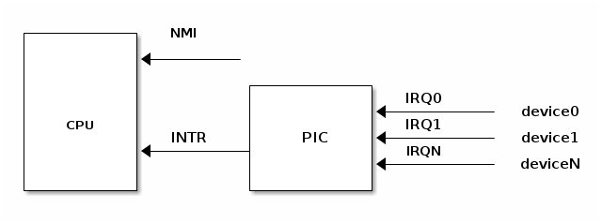
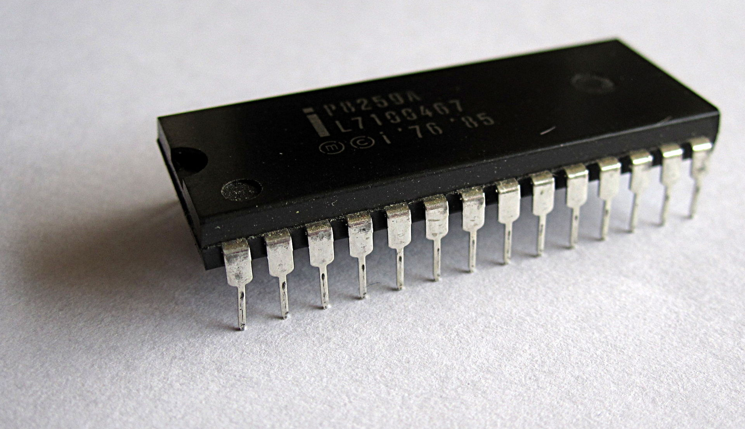
Interrupt Controller
Maskable vs. non-maskable
Intel 8259
Notes:
https://linux-kernel-labs.github.io/refs/heads/master/lectures/interrupts.html

Slide 6
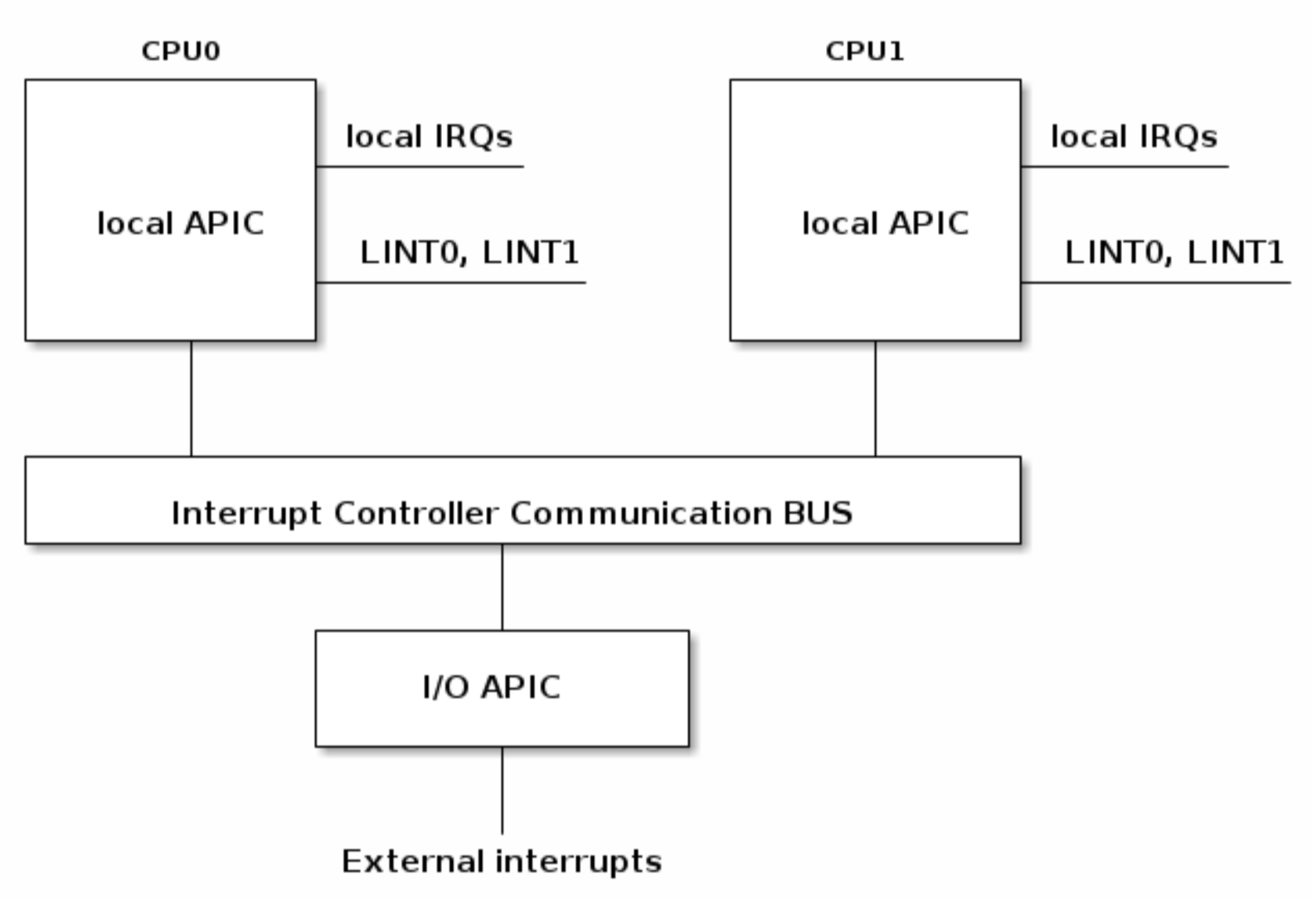
Interrupt Controller
Advanced PIC
Notes:
https://www.digiproto.com/news/221.html

Slide 7
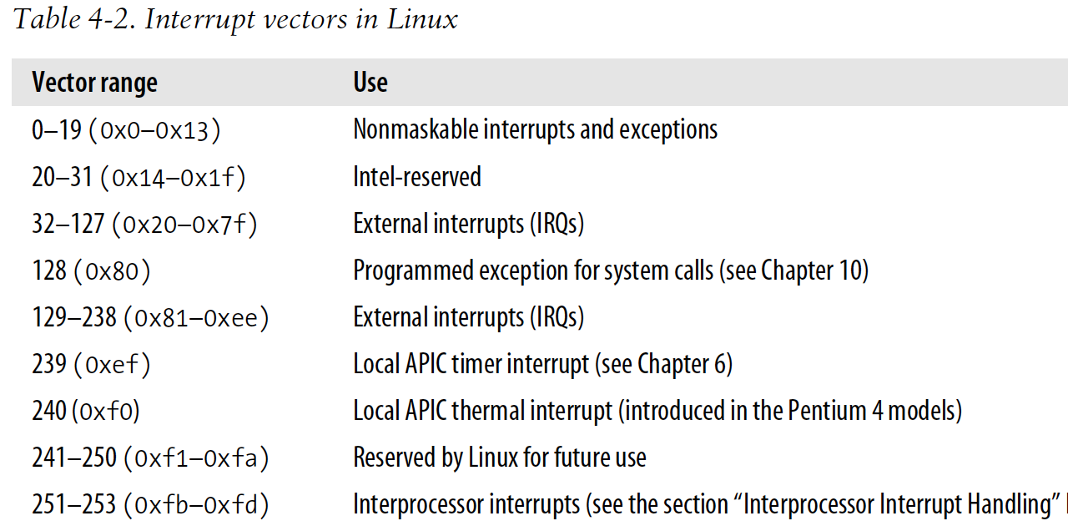
Interrupt Vector for Linux 2.6

Slide 8
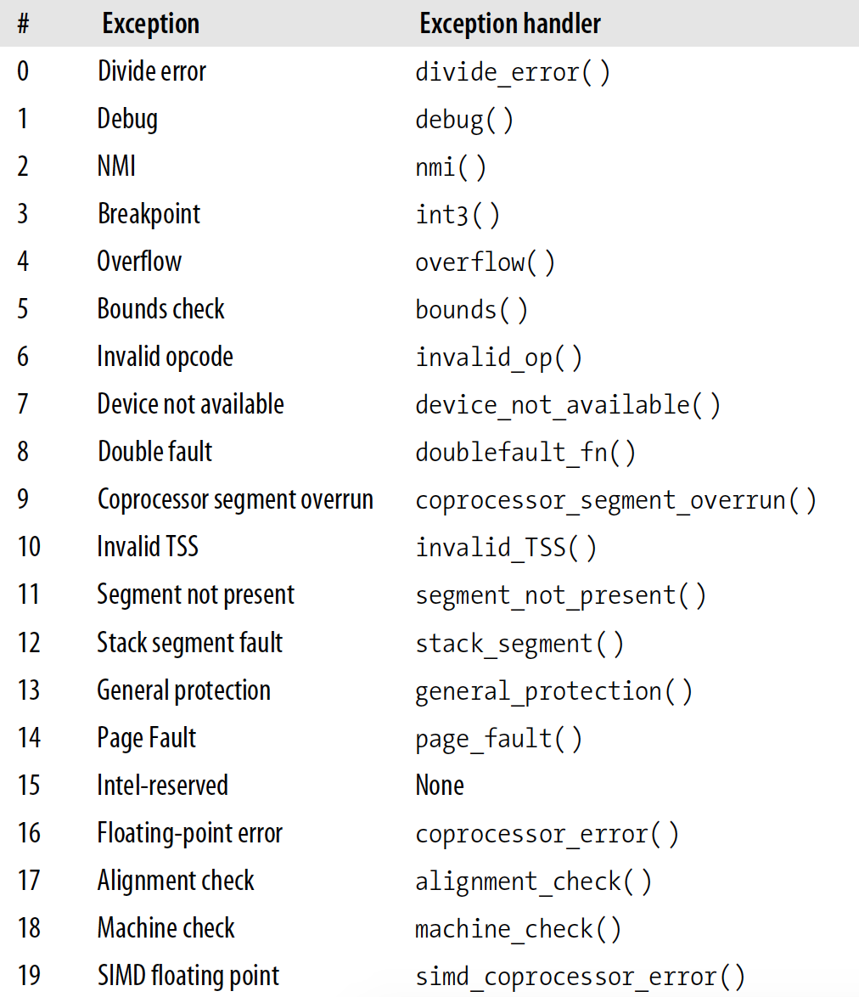
Interrupt Vector for Linux 2.6

Slide 9
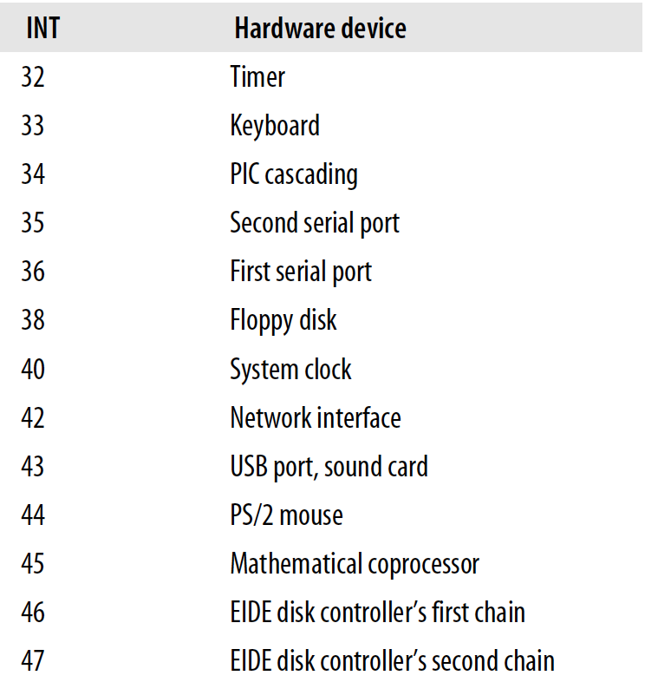
Interrupt Vector for Linux 2.6
Notes:
操作系统的脉搏

Slide 10
Interrupt Vector
Interrupt vector table
Interrupt descriptor table
Interrupt service routine

Slide 11
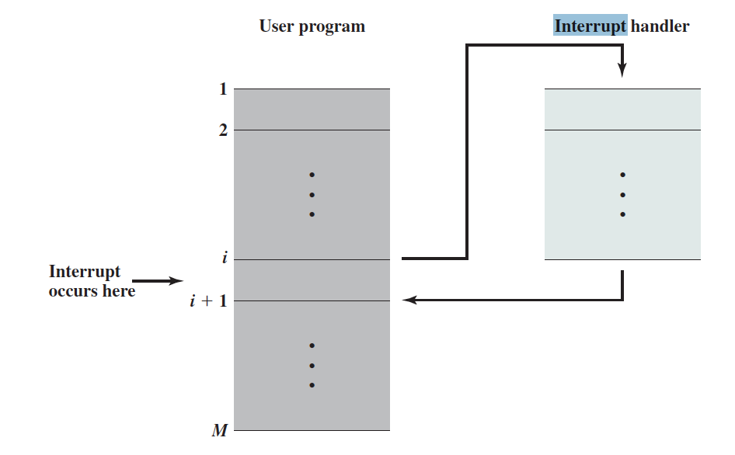
Interrupt Processing

Slide 12
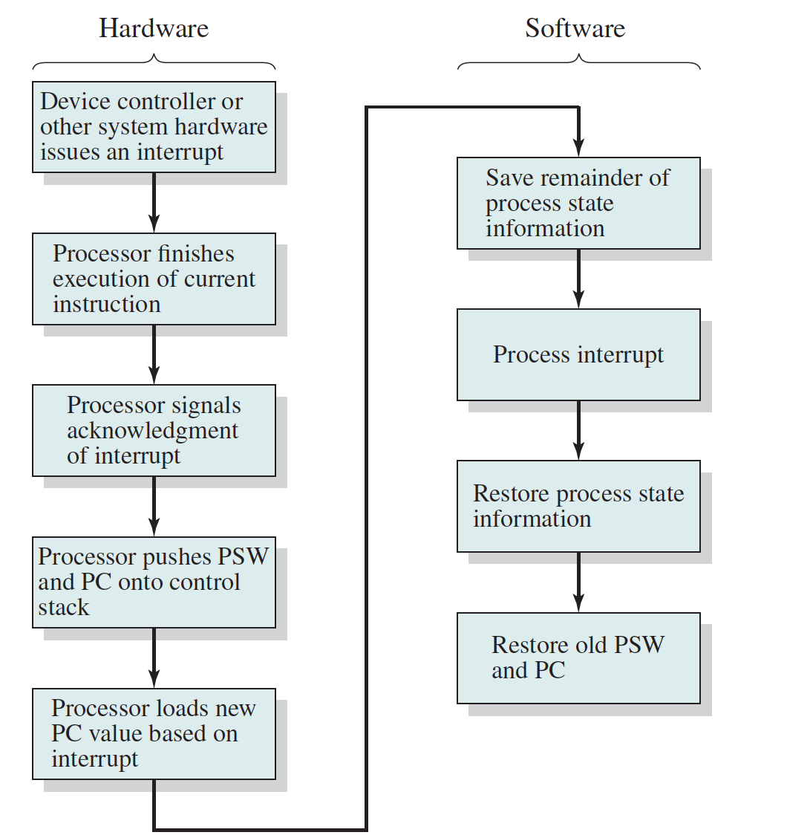
Context Save
Notes:
pc, sp, psw
Context 到第3章要重点讲

Slide 13
Timer

Slide 14
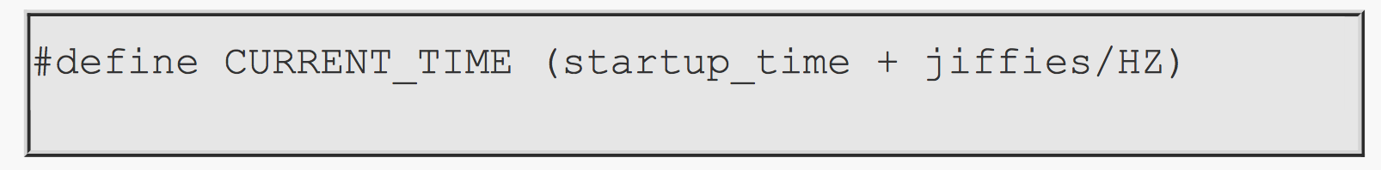
Time/Timer
Timer interrupt
HZ
jiffies: number of timer interrupts from boot
CMOS: RTC (real time clock)
UNIX time： the number of seconds that have elapsed since 00:00:00 January 1st, 1970
Time setting of your mobile phone
Notes:
cat /boot/config-`uname -r` | grep '^CONFIG_HZ='
date +%s
Jiffies
jiffies记录了系统启动以来，经过了多少tick。一个tick代表多长时间，在内核的CONFIG_HZ中定义。比如CONFIG_HZ=200，则一个jiffies对应5ms时间。所以内核基于jiffies的定时器精度也是5ms。jiffies的初始值并不是0，而是300s后即将溢出的的值。这是为了存在溢出问题的情况下，尽早暴露问题。
jiffies = jiffies_64;
include/linux/jiffies.h：
/*
* Have the 32 bit jiffies value wrap 5 minutes after boot
* so jiffies wrap bugs show up earlier.
*/
#define INITIAL_JIFFIES ((unsigned long)(unsigned int) (-300*HZ))
kernel/timer.c：
u64 jiffies_64 __cacheline_aligned_in_smp = INITIAL_JIFFIES;EXPORT_SYMBOL(jiffies_64);

Slide 15
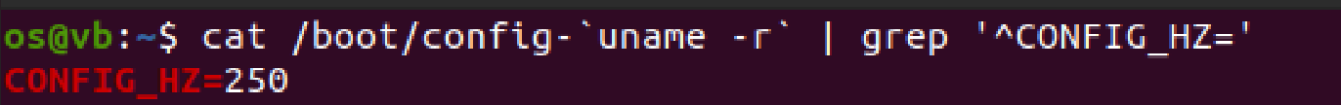
Unix Time
https://unixtime.org/
2019.03.04: 1551640580
2020.03.04: 1583317788
2021.03.08: 1615198954
2022.03.07: 1646624552
2023.03.06: 1678110083
2024.03.05: 1709608168
… …
Notes:
cat /boot/config-`uname -r` | grep '^CONFIG_HZ='
date +%s
The year 2038: 2147483647
我们知道在二进制中，32 位数能表示的最大的数是$2^{32}-1$，不过为了能够让时间可以往前往后数，会用第一位作为正负的判断位，第一位如果为 0，则说明为正；若第一位是 1，则说明为负。因此，在 Unix 或类 Unix 系统中，这$2^{32}-1$个数被分成了 2 部分，分别是$+2^{31}-1$和$-2^{31}$。这样我们就可以以 1970 年 1 月 1 日 0 点 0 分 0 秒作为时间的基准点，往前往后每过一秒就加一个数字，依此来计算时间。

Slide 16
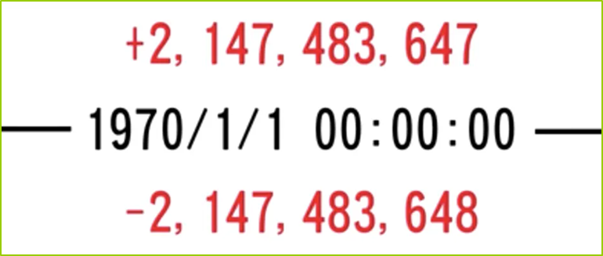

The Year 2038
32bit signed integer
Notes:
闰秒与闰年
闰秒：地球自转周期的变动（1天24时，1时3600秒，不稳定）与铯原子钟之间的协调→UTC时间（取消闰秒？）
闰年？人为历法规定造成的年度天数与地球实际公转周期的时间差

Slide 17
Summary of Interrupt
The fundamental axiom here is that at any given moment, exactly one task is active on a (single-core) CPU. Not two or more. Never zero, either. One. Always.
Cited from https://manybutfinite.com/post/when-does-your-os-run/
That's where interrupts come in.

Slide 18
The Boot Process

Slide 19
System Boot
BIOS (Basic Input-Output System)
UEFI (Unified Extensible Firmware Interface)
POST (power-on self-test)
First sector: MBR (master boot recorder), partition table
For linux: Grub
Notes:
加电－CPU－ROM－BIOS－System Clock－DMA－64KB RAM－IRQ－显卡等。检测显卡以前的过程称过关键部件测试，如果关键部件有问题，计算机会处于挂起状态，习惯上称为核心故障。另一类故障称为非关键性故障，检测完显卡后，计算机将对64KB以上内存、I／O口、软硬盘驱动器、键盘、即插即用设备、CMOS设置等进行检测，并在屏幕上显示各种信息和出错报告。在正常情况下，POST过程进行得非常快，我们几乎无法感觉到这个过程。http://mahocon.lofter.com/post/1ceb3426_6220b99
MBR包含Grub（bootloader）一部分？
MBR是硬盘上的一个扇区,包含三部分内容（引导程序、分区表及分隔标识，MBR总计512字节；其中引导程序最多占446个字节）；为什么需要这个MBR，主要是因为BIOS太小，功能有限。当系统加电，bios自检后，就会将MBR Load进内存。也就意味着引导程序被激活，分区表信息已经加载到内存，同时也意味着对系统的控制权从bios过渡到GRUB.GRUB是GRand Unified Bootloader的缩写，它是一个多重操作系统启动管理器。用来引导不同系统。
GRUB是一个系统引导程序，分为两个阶段，
第一阶段它保存在MBR中.用汇编语言编写，也就是MBR中的引导程序部分。①基本的硬件设备初始化（屏蔽所有的中断、关闭处理器内部指令/数据cache 等）。②为加载 Bootloader 的Stage2 准备空间。③如果是从某个固态存储媒质中，则拷贝 Bootloader 的stage2 到RAM 空间中。④设置好堆栈。⑤跳转到 stage2 的C 程序入口点。
GRUB引导程序的第二阶段，通常用C语言编写，这个阶段的任务有： ①初始化本阶段要使用到的硬件设备。②检测系统内存映射。③将kernel 映像和根文件系统映像从flash 上读到RAM 空间中。④为内核设置启动参数⑤调用内核。
它通常保存在/boot/grub/中。 当我们启动系统进入GRUB界面时，会看到有选择信息，如果我们自己编译了系统内核的话，你可以选择从某个内核启动。同时要注意的是GRUB的配置文件和内核在/boot分区。从前面分析我们可以看出，/BOOT和MBR不存在包含关系。GRUB第一阶段需要去MBR中去读引导程序，GRUB第二阶段需要到/boot分区读系统内核和配置文件。
BOIS >>MBR （第一个磁盘的第一个分区）>>在MBR中读取grub引导程序

Slide 20
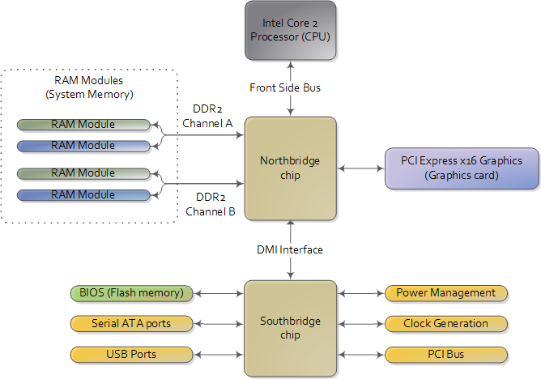
Motherboard Chipset
Pictures:
http://duartes.org/gustavo
/blog/archives/
Notes:
Switch computer???

Slide 21
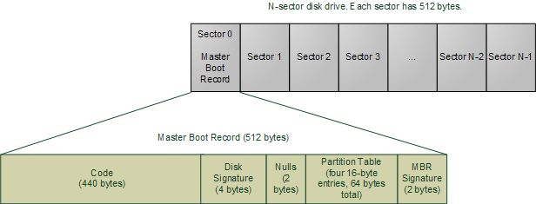
MBR Structure
Pictures: http://duartes.org/gustavo/blog/archives/

Slide 22
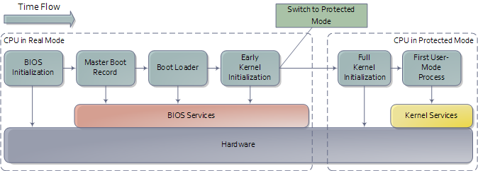
Boot Process
Control of CPU

Slide 23
User vs Kernel

Slide 24
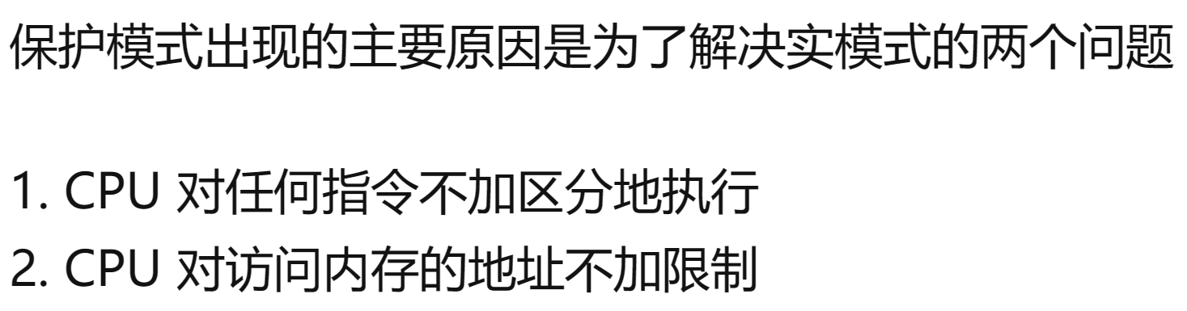
Protected Mode
Control of CPU
real
protected
Notes:
X86-64: long mode
https://cloud.tencent.com/developer/article/2031760

Slide 25
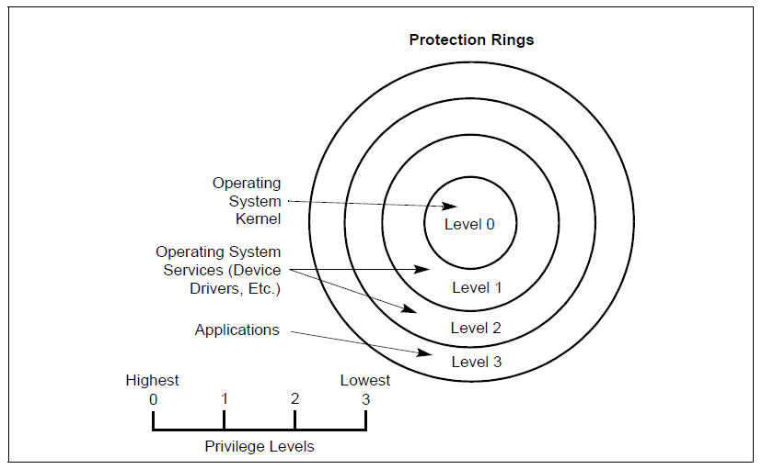
CPU Protection Ring

Slide 26
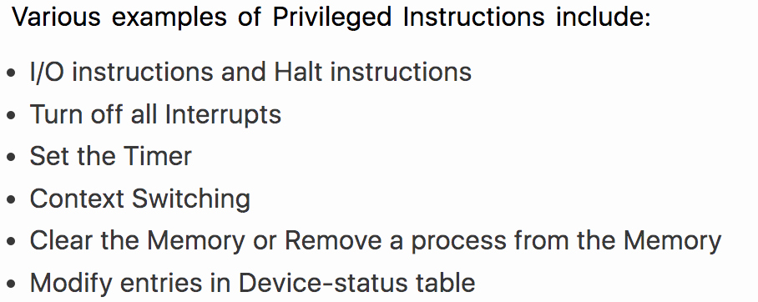
Privileged Instruction
特权指令举例

Slide 27
Protected Mode
Control of CPU
User space
Ring 3
Kernel space
Ring 0
Notes:
X86-64: long mode

Slide 28
Operating-System Operations (cont.)
Dual-mode operation allows OS to protect itself and other system components
User mode and kernel mode
Mode bit provided by hardware (CPU的特殊寄存器)
Provides ability to distinguish when system is running user code or kernel code
Some instructions designated as privileged, only executable in kernel mode
Notes:
从使用的方便角度
从使用的安全角度
内存分配（malloc）

Slide 29
Why Dual Mode
Protection
Privileged instruction in kernel mode
Memory access control
可以随意提权吗？
Notes:
How to switch? Segment register?

Slide 30
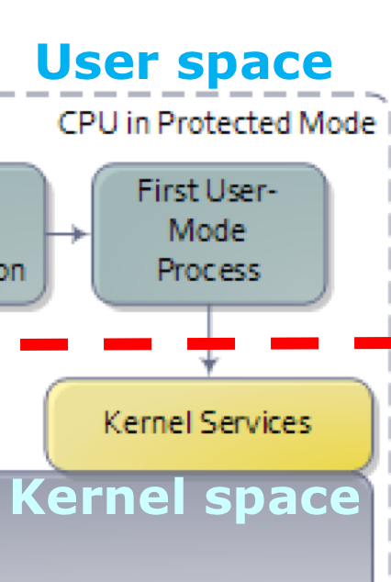
Interrupt Handling
中断时自动提权
中断返回时自动降权

Slide 31
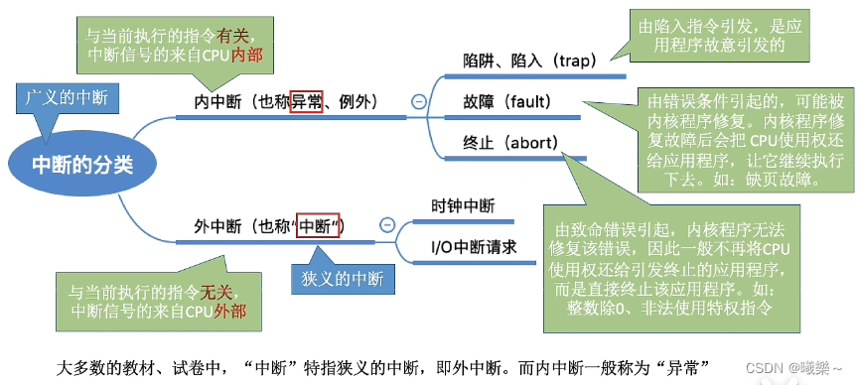
内中断和外中断
Notes:
系统调用导致的是内中断

Slide 32
中断（Interrupt）
中断是硬件或软件发出的信号，用以通知CPU暂停当前正在执行的程序，转而处理一个更高优先级的事件。中断可以由多种来源触发，包括：
硬件中断：由外部硬件设备（如键盘、鼠标、定时器、网络接口等）产生的中断。
软件中断：由程序执行特定指令（如系统调用）或异常情况（如除零错误、访问违规等）产生的中断。
中断处理过程通常包括：
中断请求：硬件设备或软件条件触发中断请求。
中断服务例程（ISR）：操作系统中的中断服务例程响应中断请求，执行必要的处理，如读取设备数据或记录异常信息。
返回主程序：中断处理完成后，CPU返回到被中断的程序继续执行。

Slide 33
系统调用（System Call）
系统调用是用户空间程序请求操作系统服务的一种方式。它是操作系统内核提供给用户程序的接口，允许用户程序请求操作系统执行特定的功能，如文件操作、进程控制、通信等。
系统调用的典型过程包括：
用户程序发起请求：用户程序通过库函数触发系统调用。
进入内核模式：系统调用导致从用户模式切换到内核模式，因为操作系统内核是管理硬件资源的核心。
执行服务：内核执行请求的服务，如分配资源、管理进程等。
返回用户空间：服务完成后，控制权返回给用户程序，继续执行。

Slide 34
区别
触发方式：中断是由外部事件触发的，而系统调用是由用户程序主动发起的。
目的：中断用于处理紧急事件或响应硬件状态变化，系统调用用于请求操作系统服务。
上下文切换：中断处理通常涉及硬件上下文的切换，系统调用涉及用户空间到内核空间的上下文切换。
优先级：中断通常具有高优先级，可以中断当前的CPU执行流程；系统调用则是用户程序的正常执行流程。
处理过程：中断处理通常很快，因为它们只需要记录事件或状态；系统调用可能需要较长时间的处理，因为它们涉及复杂的系统资源管理

Slide 35
System Services

Slide 36
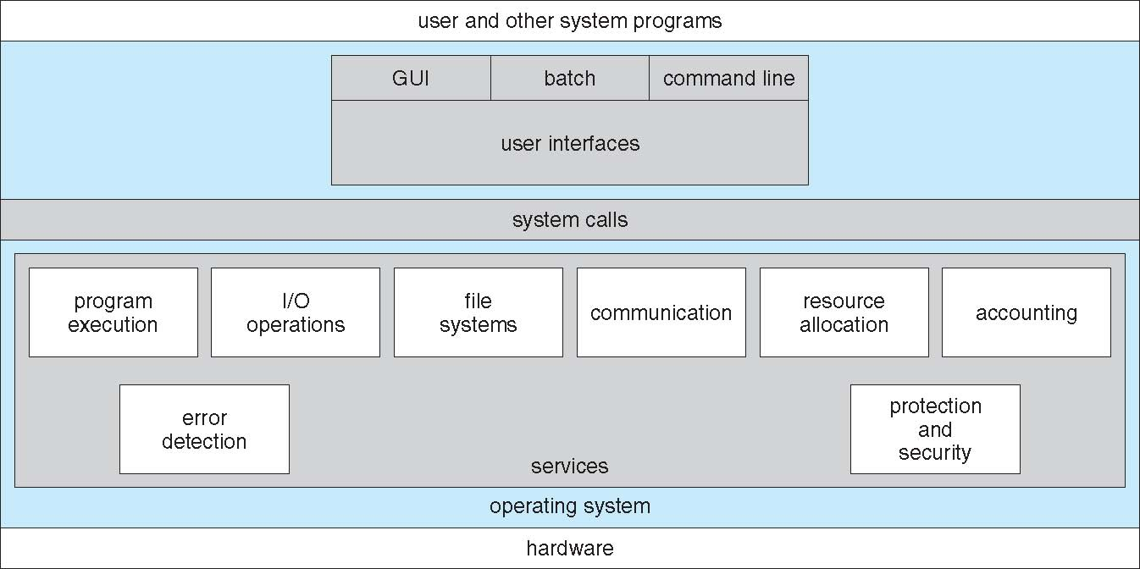
A View of Operating System Services

Slide 37
User Operating System Interface - CLI
CLI(Command-Line Interface) or command interpreter allows direct command entry
Sometimes implemented in kernel, sometimes by systems program
Sometimes multiple flavors implemented – shells
Primarily fetches a command from user and executes it
Sometimes commands built-in, sometimes just names of programs
If the latter, adding new features doesn’t require shell modification

Slide 38
User Operating System Interface - GUI
User-friendly desktop metaphor interface
Usually mouse, keyboard, and monitor
Icons represent files, programs, actions, etc
Various mouse buttons over objects in the interface cause various actions (provide information, options, execute function, open directory (known as a folder)
Invented at Xerox PARC
Many systems now include both CLI and GUI interfaces
Microsoft Windows is GUI with CLI “command” shell
Apple Mac OS X is “Aqua” GUI interface with UNIX kernel underneath and shells available
Unix and Linux have CLI with optional GUI interfaces (CDE, KDE, GNOME)

Slide 39
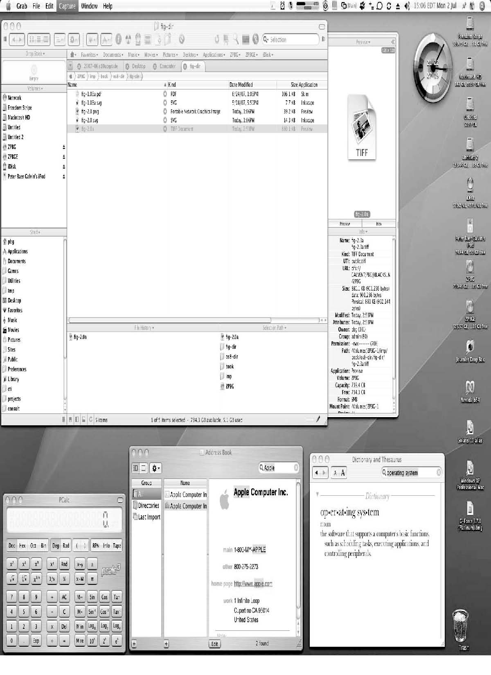
The Mac OS X GUI

Slide 40
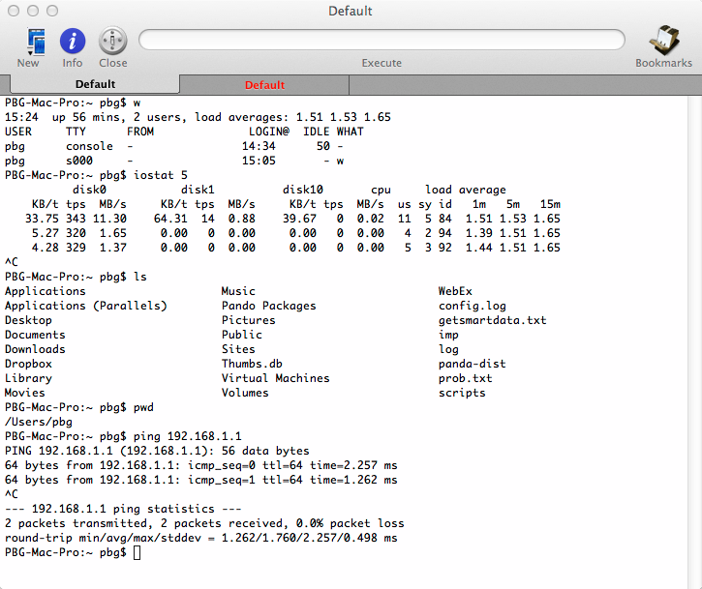
MacOS CLI

Slide 41
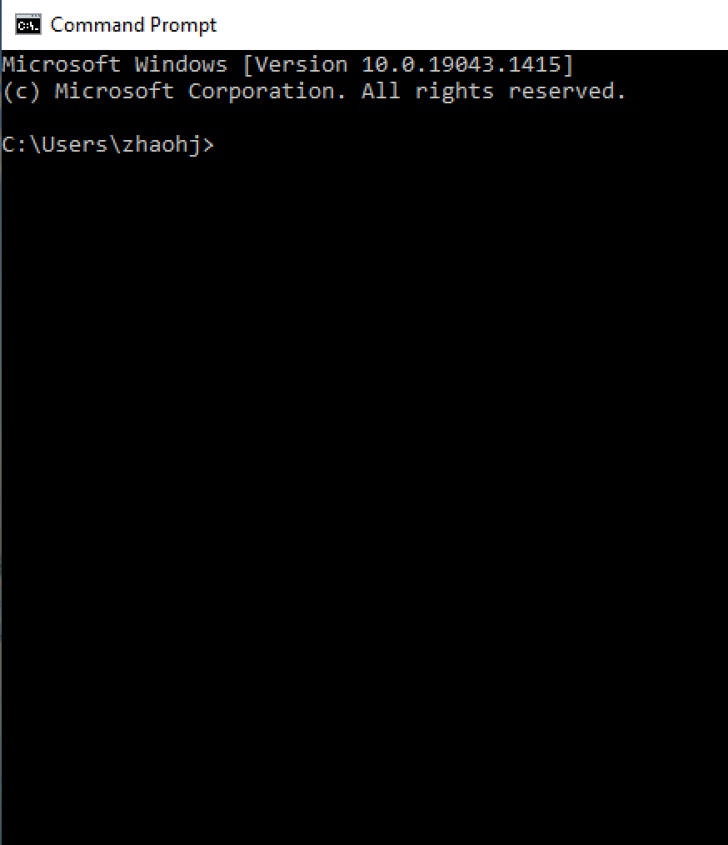
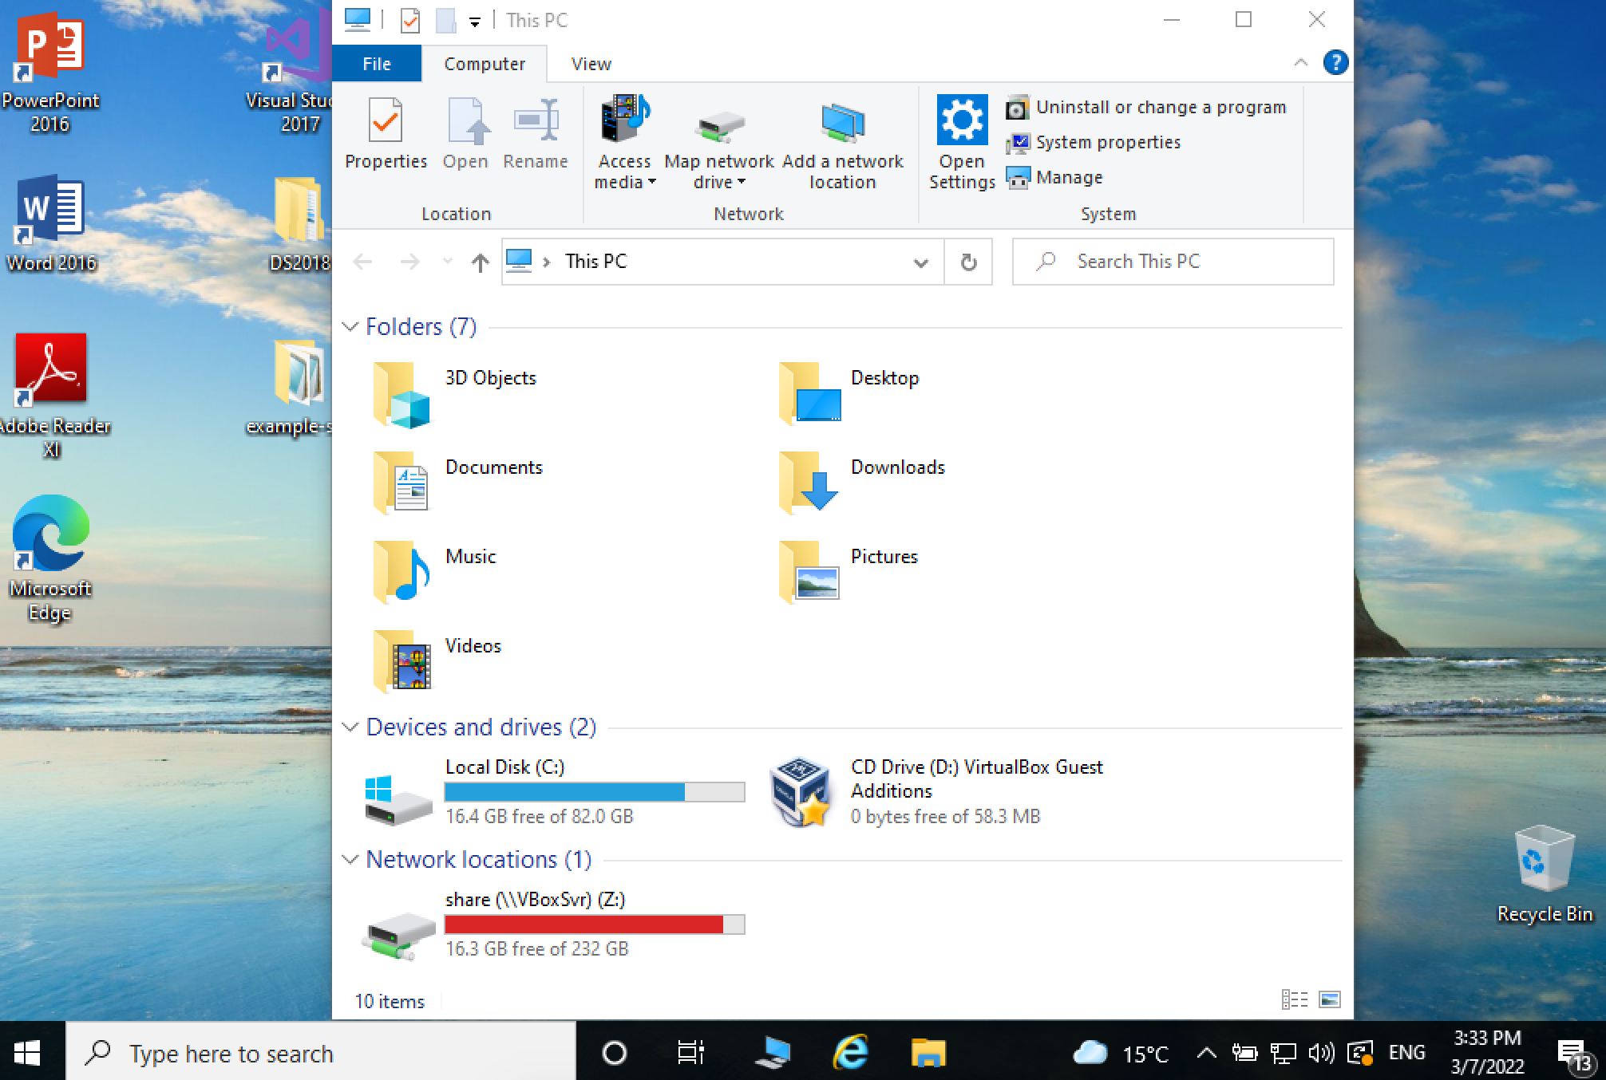
Windows GUI&CLI

Slide 42
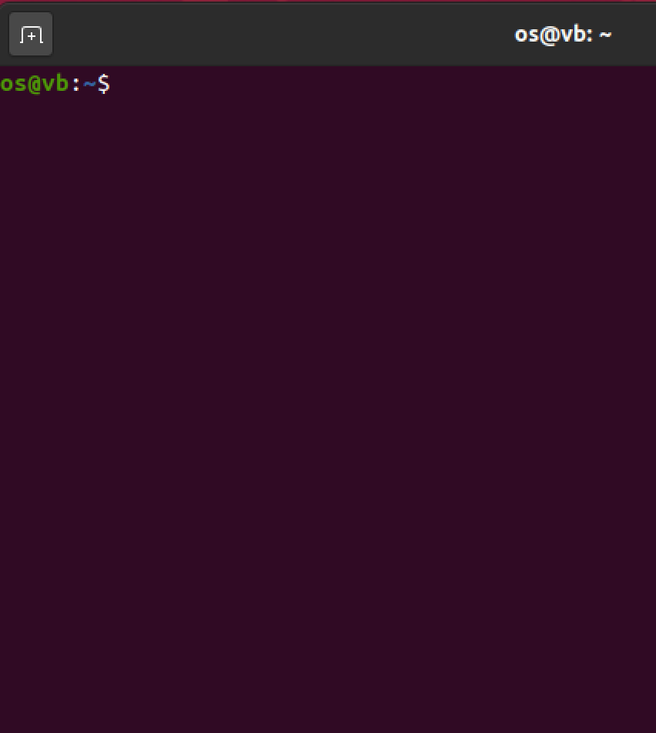
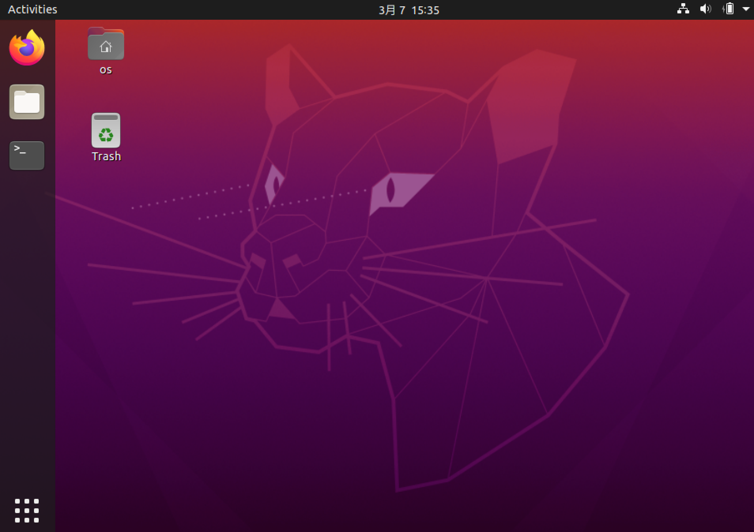
Ubuntu Linux GUI&CLI

Slide 43
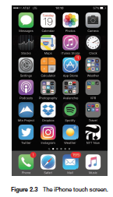
Touchscreen Interfaces
Touchscreen devices require new interfaces
Mouse not possible or not desired
Actions and selection based on gestures
Virtual keyboard for text entry
Voice commands.

Slide 44
A View of Operating System Services

Slide 45
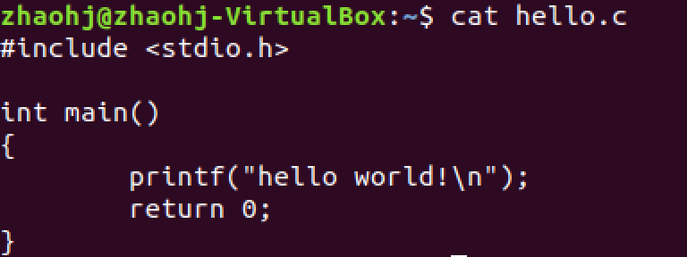
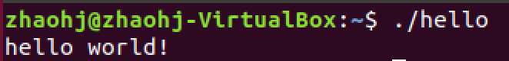
C Program： Hello World
C API
Notes:
For programmers, interfaces are APIs

Slide 46
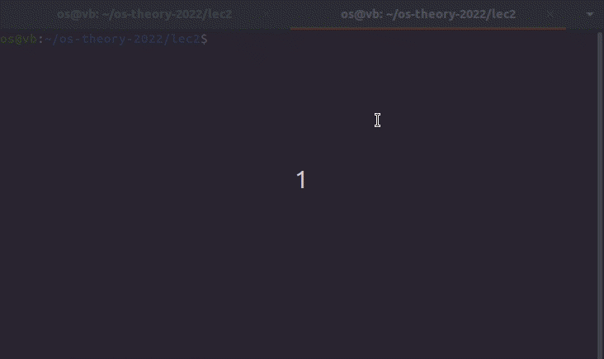
Inside printf() and scanf()
Hello world
Notes:
Give an example: strace ./a.out %%hello world!
ltrace ./a.out

Slide 47
System Call

Slide 48
System Calls
Programming interface to the services provided by the OS
Typically written in a high-level language (C or C++)
Mostly accessed by programs via a high-level Application Programming Interface (API) rather than direct system call use
printf() [write()]
Scanf() [read()]

Slide 49
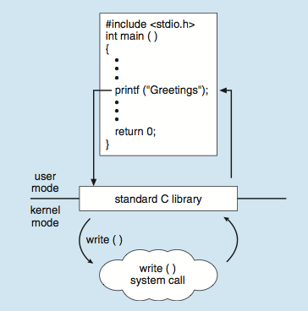
API – System Call – OS Relationship
C program invoking printf() library call, which calls write()
Notes:
Give an example: strace hello world

Slide 50
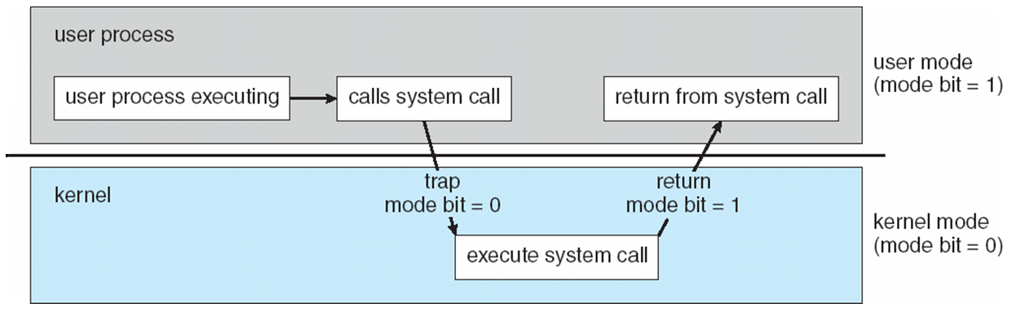
Transition from User to Kernel Mode
通过特殊的系统调用指令实现提权
But?

Slide 51
System Call Implementation

Slide 52
System Call Parameter Passing
Often, more information is required than simply identity of desired system call
Exact type and amount of information vary according to OS and call
Three general methods used to pass parameters to the OS
Simplest: pass the parameters in registers
In some cases, may be more parameters than registers
Parameters stored in a block, or table, in memory, and address of block passed as a parameter in a register
This approach taken by Linux and Solaris
Parameters placed, or pushed, onto the stack by the program and popped off the stack by the operating system
Block and stack methods do not limit the number or length of parameters being passed

Slide 53
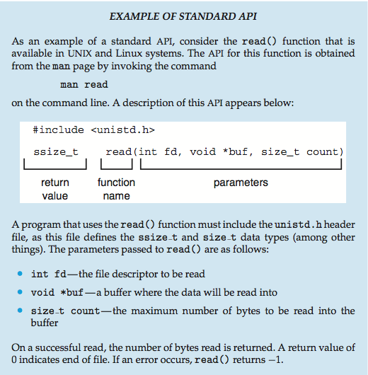
Example of Standard API
Notes:
Give an example: strace ./a.out %%hello world!
ltrace ./a.out

Slide 54
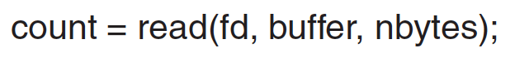
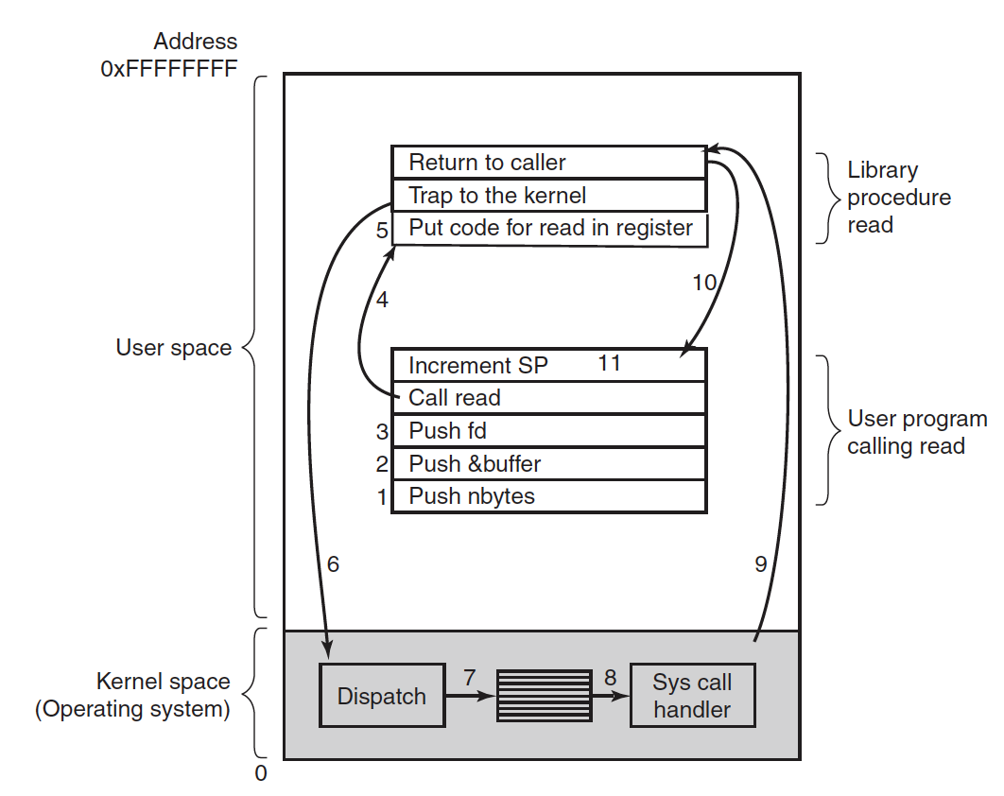
Notes:
scanf()
->
read()
->sys_read()
!!!: read wrapper
!!!: stack (kernel???)

Slide 55
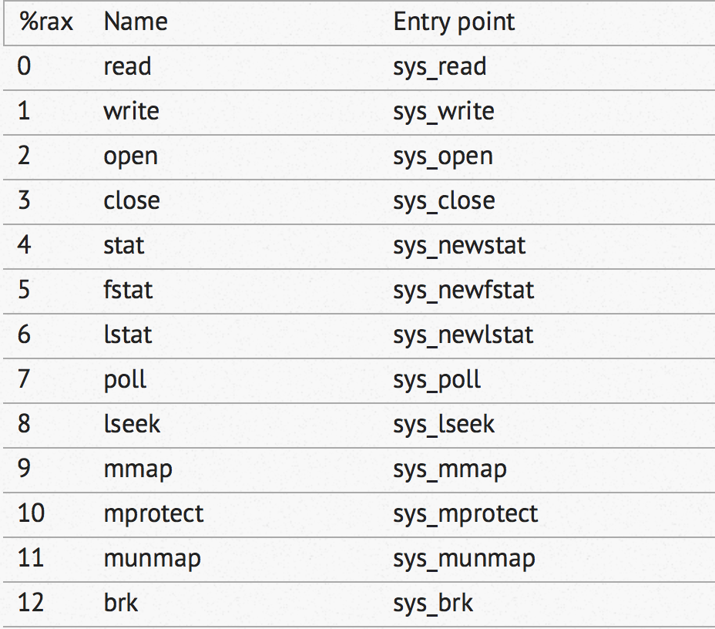
Linux System Call List
Notes:
https://github.com/torvalds/linux/blob/v3.17/arch/x86/syscalls/syscall_64.tbl
More than 500

Slide 56
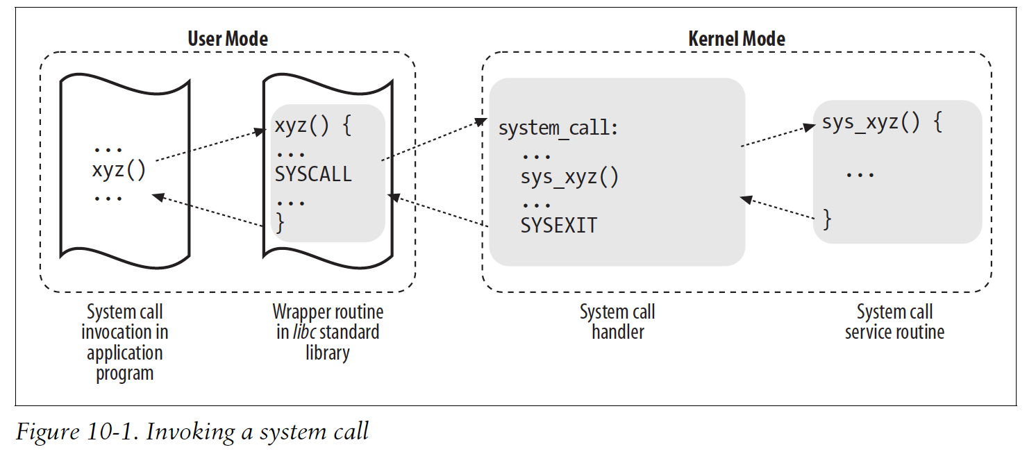
System Call: Summary

Slide 57
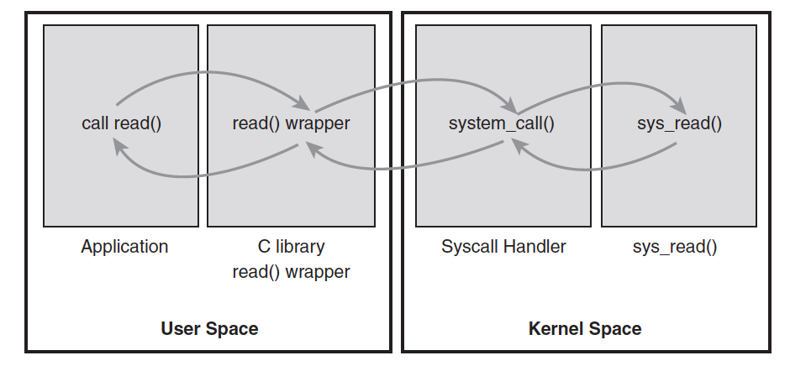
System Call: Summary

Slide 58
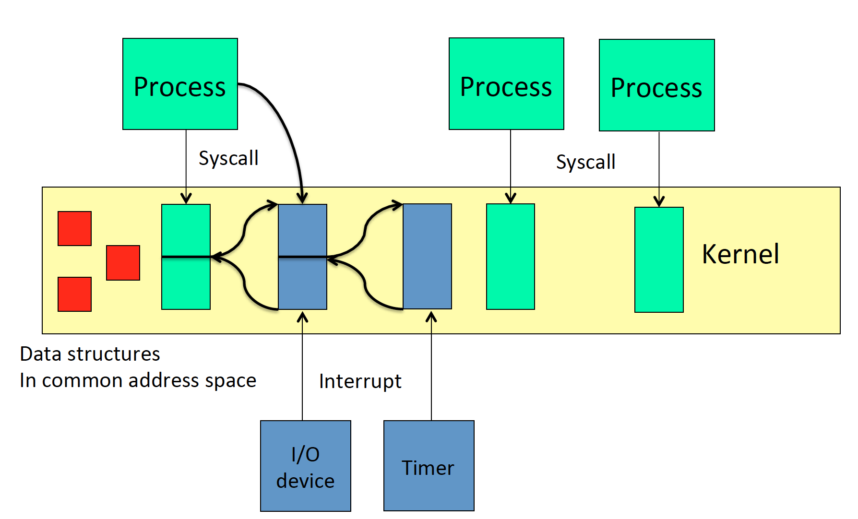
Summary: User vs Kernel
狭义的interrupt，外中断
Notes:
data structures: PCB etc.

Slide 59
Types of System Calls
Process control
create process, terminate process
end, abort
load, execute
get process attributes, set process attributes
wait for time
wait event, signal event
allocate and free memory
Dump memory if error
Debugger for determining bugs, single step execution
Locks for managing access to shared data between processes

Slide 60
Types of System Calls
File management
create file, delete file
open, close file
read, write, reposition
get and set file attributes
Device management
request device, release device
read, write, reposition
get device attributes, set device attributes
logically attach or detach devices

Slide 61
Types of System Calls (Cont.)
Information maintenance
get time or date, set time or date
get system data, set system data
get and set process, file, or device attributes
Communications
create, delete communication connection
send, receive messages if message passing model to host name or process name
From client to server
Shared-memory model create and gain access to memory regions
transfer status information
attach and detach remote devices

Slide 62
Types of System Calls (Cont.)
Protection
Control access to resources
Get and set permissions
Allow and deny user access

Slide 63
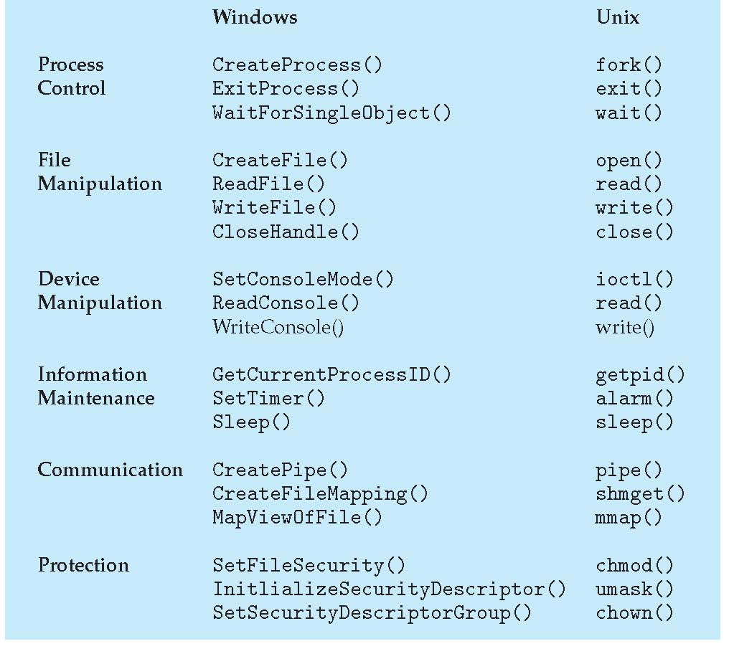
Examples of Windows and Unix System Calls

Slide 64
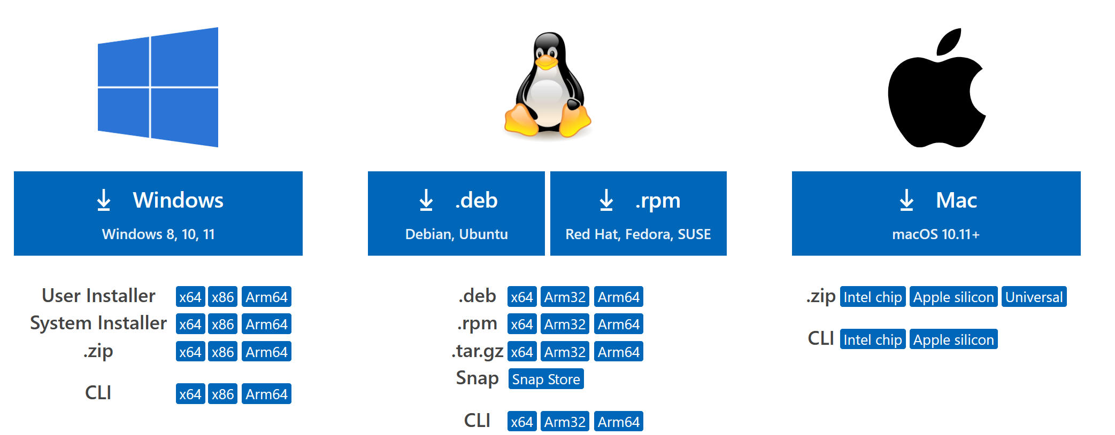
Question
Why Applications Are Operating-System Specific?
Demo 1: hello world
Demo 2: vscode download
https://code.visualstudio.com/#alt-downloads
Notes:
https://code.visualstudio.com/#alt-downloads
The ‘file ***’ command in Linux
https://code.visualstudio.com/Download
Reasons are:
Instruction set
Executable file format
Dynamically linked library
System call

Slide 65
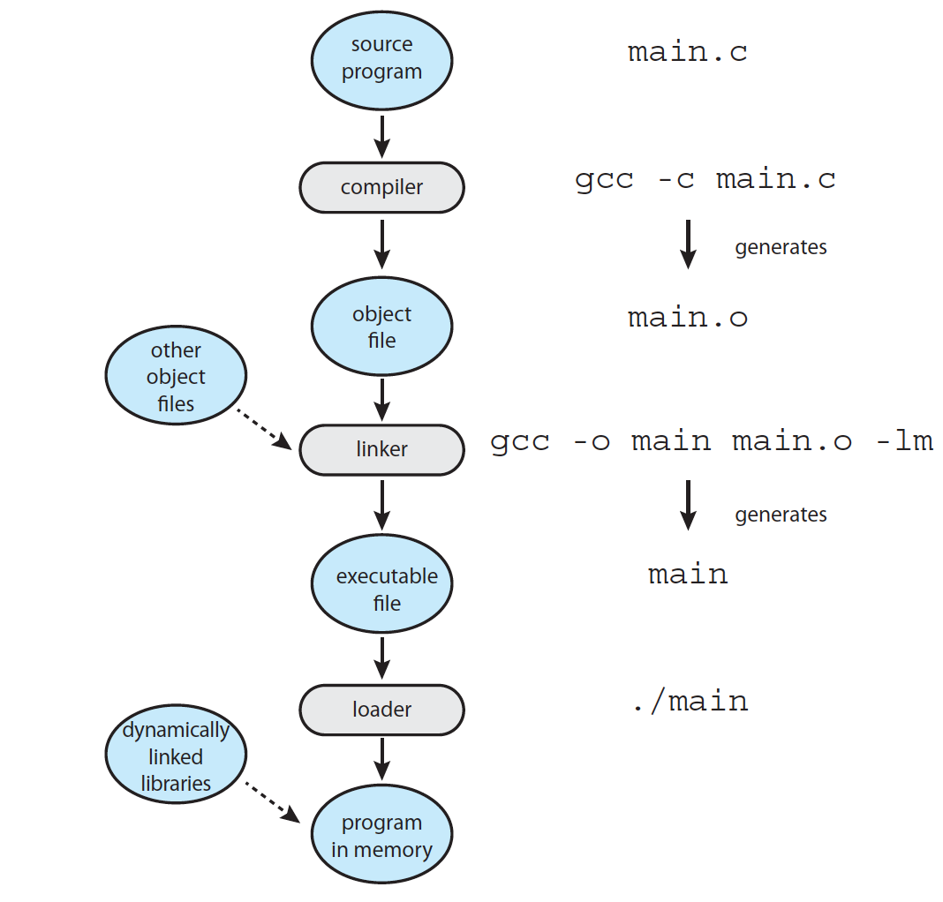
Linker and Loader
Notes:
Dynamically linked library

Slide 66
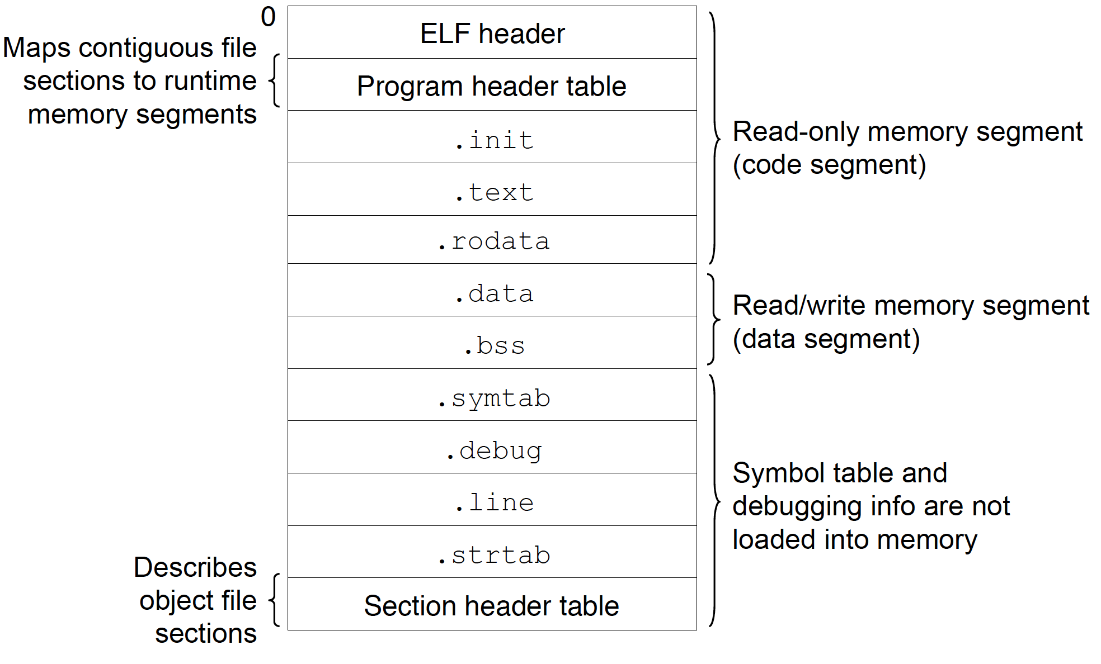
Executable Binary for Linux
Notes:
Executable file format

Slide 67
Operating System Structure

Slide 68
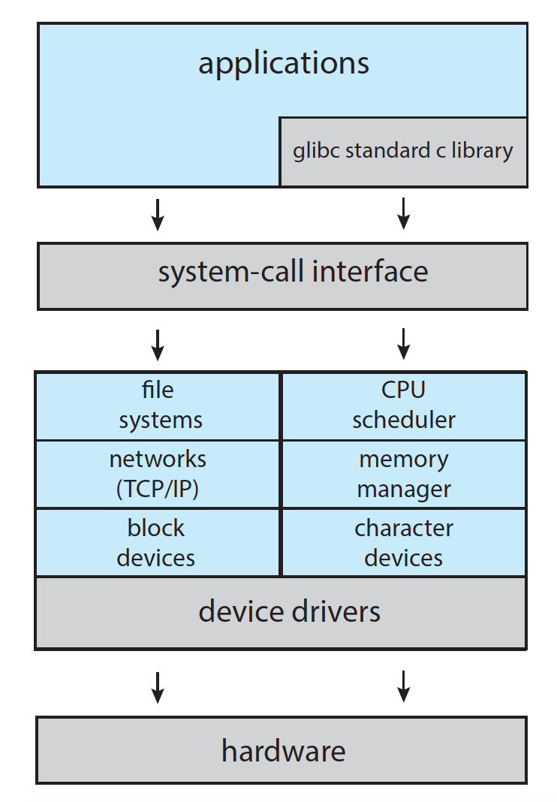
Monolithic: Linux
Demo1
Demo2
Notes:
C:\Windows\System32\ntoskrnl.exe
\boot\vmlinuz-4.4.0-31-generic
\boot\vmlinuz-5.3.0-40-generic (18.04.4)
ls -lh

Slide 69
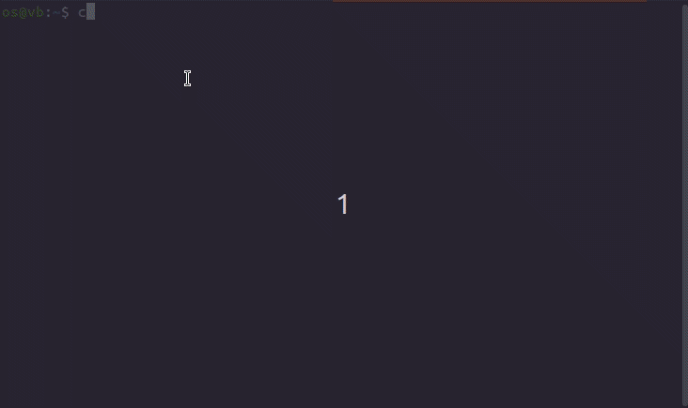
Linux Kernel

Slide 70
Microkernel System Structure

Slide 71
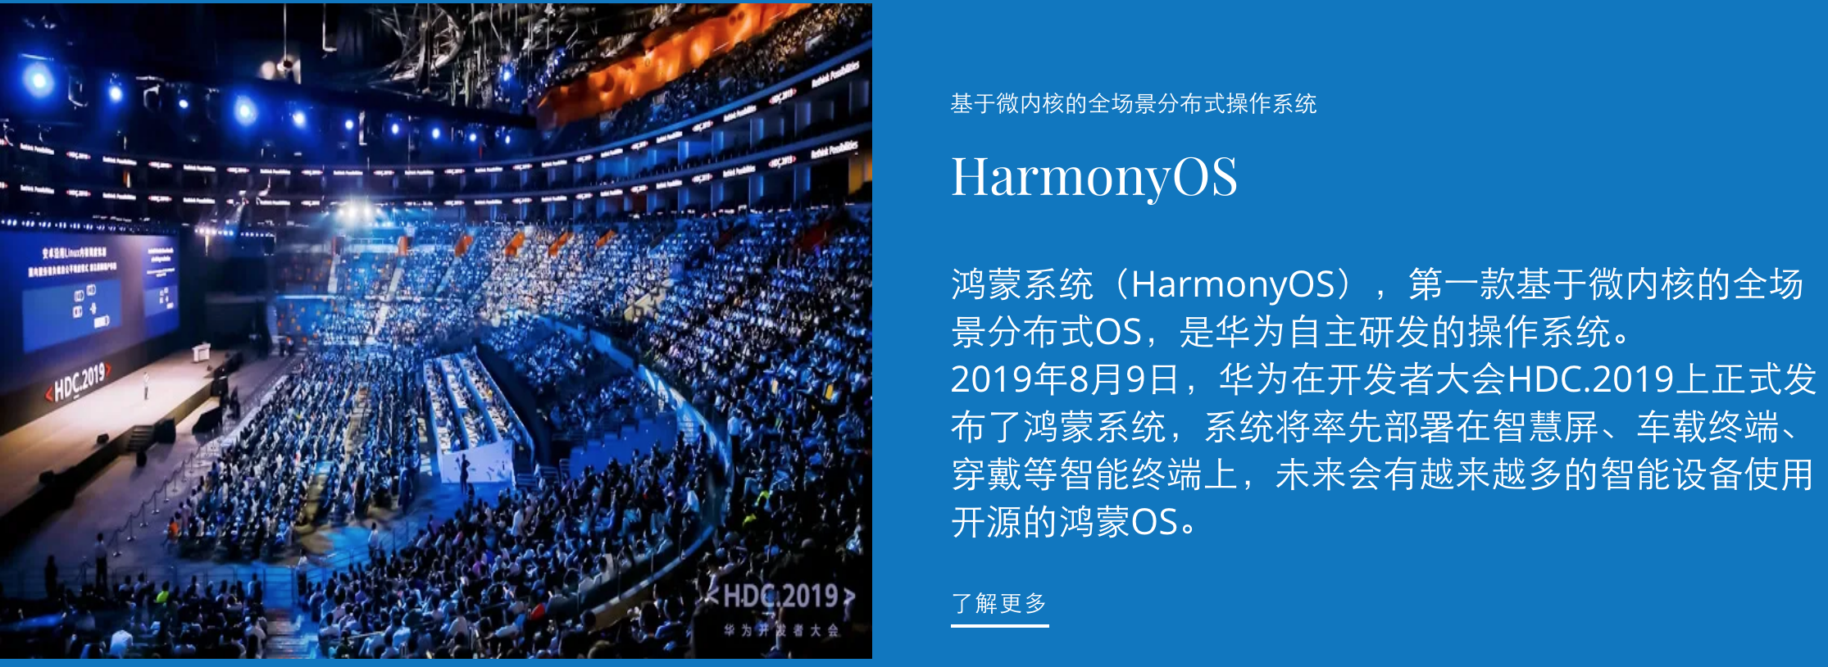
Harmony OS
微内核、全场景、分布式
https://hmxt.org/

Slide 72
End of Chapter 2

Slide 73
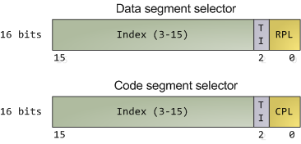
CPU Protection Ring
Pictures: http://duartes.org/gustavo/blog/archives/

Slide 74
Protected Mode
Control of CPU
real
protected
User space
Kernel space

Slide 75
Interrupt Handling

Slide 76
Interrupt Vector for Linux
May be obsolete
Notes:
syscall

Slide 77
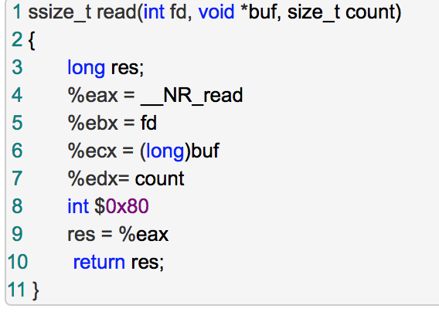
Read Wrapper
Notes:
#define __NR_read 3
//这种实现方式是否陈旧？
Syscall? Sysenter?

Slide 78
Summary
read():
int 0x80
sys_read
Interrupt vector table: 0x80
system_call:
system call NO.

Slide 79
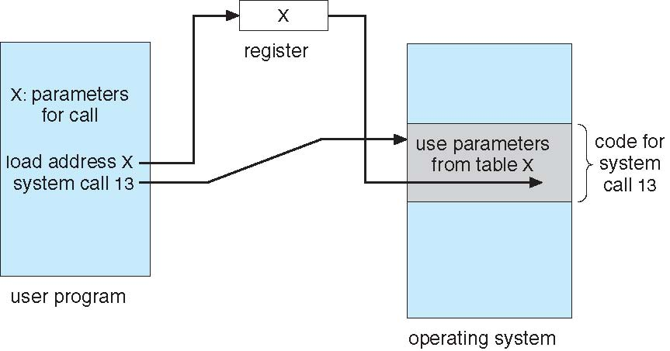
Parameter Passing via Table

Slide 80
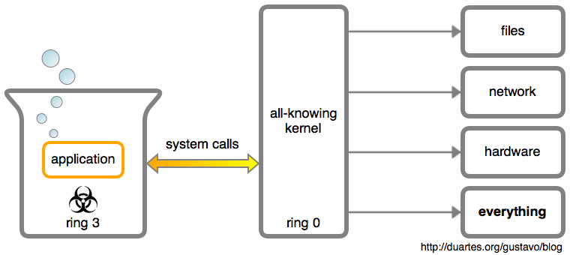
System Calls

